Slide 1
Group 6 Project Presentation
Nathan R, Dominic O, Drew F, Jalen G, Michael M, Daniel A

Slide 2

Work Contributions
Daniel: Made the game and integrated it into the site
Dominic: Made the gym locator and a large part of the documentation
Drew: Designed the web pages, headed the debugging process whenever issues arose, and helped establish and update the group repository.
Jalen: Use cases’ written descriptions, website design suggestions
Michael: Research, backend, and member functionalities
Nathan: High-Level Architecture, Social Media, Payment

Slide 3

Hosting
For hosting our website used the Hosting Website Hostinger which gave us many different options.
The group decided to go to go with cPanel as a hosting plan, which came with a large number of tools and perks. These included WordPress manager, which allowed us to customize our website, use addons and plugins, and generally simplified many processes that improved our website.

Slide 4
Website Design
Various home pages:
For guest users
Students
Parents
etc.
From the various homepages users can navigate the website to the pages they want (which suit their role). Some pages are available from the guest home page (registration, log in, gym locator) but most require an account.
The game is available from the student homepage.

Slide 5
Account Management
Different users and role account types (athlete, coach, parent, professional) will have different functions.
Student | Parent | Coach | Commercial
Game Access | Particular Student Info | All Student Info | Student Info
Social Media | Contact Information | Remove/Add Students | Team Profiles
GPS Info | GPS Info | GPS Info
 | Social Media | Team Profiles

Slide 6

Database
Since the website is hosted through cPanel, it determined the architecture of our back-end.
cPanel comes with MySQL database support. The project database holds:
Web page data
User data
Metadata

Slide 7
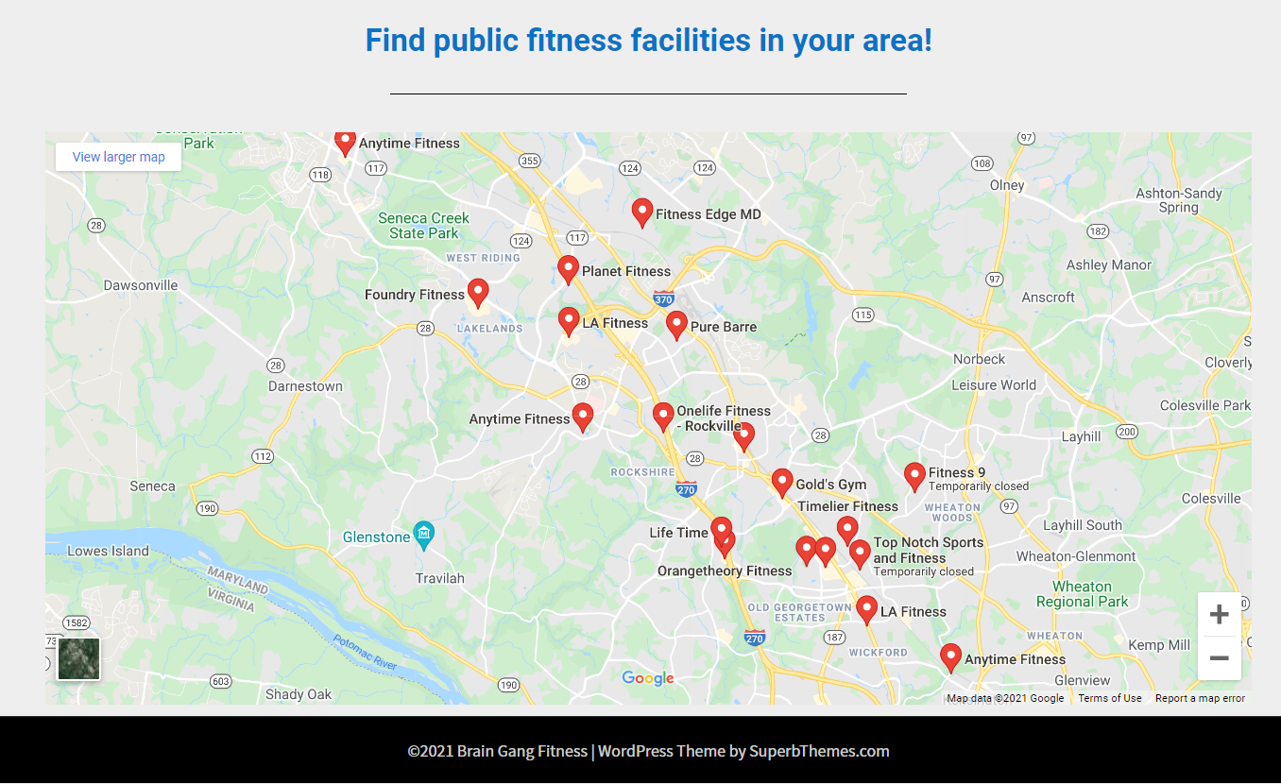
Gym Locator
Google Maps API
Embedded into web page using Elementor Google Maps Widget
Shows results in user specific location
Results show location info, hours, address, directions, etc.

Slide 8


Social Media
2 Buttons that connect to social media
Twitter creates a presconstructed tweet advertising the site and linking it.
Facebook creates a post that links the site. User has to create a post for it.

Slide 9

Payment Processing
WooCommerce will be our payment processing platform.
WooCommerce includes a variety of different options for online payments including subscription based payment processing.
Our subscription based payment system has 4 different levels so it can match a consumer’s potential income range.
Using their API and documentation, we will direct all payments to be handled by their pre-existing and secure portals that will be integrated into our payment page.

Slide 10
Game Design
We’ve created a demo of the game based off online video tutorials.
Objective
Gameplay is based on an in-game character. The character is controlled by the user and has a set time limit to try to collect various foods, unhealthy foods and healthy foods that pop up around them.
When enough of certain food types is collected, general nutritional information about the food will be displayed on screen. Users will be able to learn about what foods are and aren’t good for them.
The user will play until he or she gets a negative score or eats three unhealthy foods. After the game ends the user will be prompted to the nutrition facts page to learn more about the foods.

Slide 11
Plans for Incomplete Features
Team Profiles: Implement additional features for profile systems.
Student Information: Coaches are currently unable to see Student information.
Completing Payment Linking: Issues with Paypal regarding business account.
Commercial Functionality: No current system for businesses to provide their services.
Subscription Connectivity: The subscription doesn’t provide any differences.
Connecting Student and Parent: Making Parent account associated with student accounts.

Slide 12




Tools and Languages
Main Languages: Javascript, PHP
Javascript Runtime Environment: NodeJS
Software: Wordpress Manager
Webpage Editor: Elementor
Database: MySQL
IDE for Game: Visual Studio Code
Project Repository: GitHub
Website Hosting: cPanel at Hostinger

Slide 13
Website Demo

Slide 14
THANK YOU

Slide 15
Resources
JavaScript 2D Game Tutorial - https://www.youtube.com/watch?v=jl29qI62XPg
Website Hosting - https://infinityfree.net/
WooCommerce - https://woocommerce.com/
Github - https://github.com/
Node JS - https://nodejs.org/en/
Visual Studio Code - https://code.visualstudio.com/
Google Maps API - https://developers.google.com/maps/documentation/embed/map-generator#cleaning-up

